Slide 1


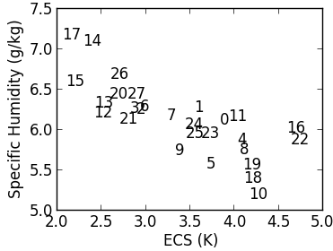
Statistical Significance of Climate Sensitivity Predictors Obtained by Data Mining (accepted by GRL 2/13/14)
P. M. Caldwell, C. S. Bretherton, M. D. Zelinka, S. A. Klein, B. D. Santer, & B. M. Sanderson
Office of Science
Idea:
Equilibrium climate sensitivity (ECS, surface warming expected from CO₂ doubling) is a critical measure of global warming
Several recent studies estimate ECS by establishing relations between ECS and currently observable quantities (e.g. Fig. 1)
We search through >40,000 current-climate fields for predictors of ECS and test the statistical significance of the results
  This requires a new technique for testing significance of the best correlations out of a huge dataset containing dependencies across fields and between models
Results:
Strong correlations are expected by chance
None of the current-climate predictors tested are significant at the 95% level.
Robust identification of observable predictors of ECS require a convincing physical mechanism
The best data-mined predictors of ECS are related to the Southern Ocean, suggesting this is a likely place to search for mechanisms connecting current climate to ECS
Fig 1: Relationship between ECS and the best-correlated current-climate predictor (summer-time specific humidity at 1000 mb averaged over 30-50S ). Each number represents a CMIP5 model.
Publication:
Caldwell, P.M., C.S. Bretherton, M.D. Zelinka, S.A. Klein, B.D. Santer, and B.A. Sanderson: Statistical Significance of Climate Sensitivity Predictors Obtained by Data Mining. Geophys. Res. Letters. Accepted. doi: 10.1002/2014GL059205
Fig 2: Number of fields correlated with ECS at >0.7 in absolute value as a function of the number of independent models assumed (blue line) and number expected by chance at 95% confidence level (red line).

