Slide 1
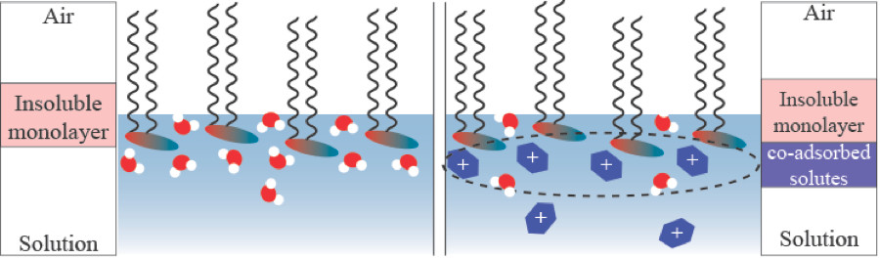
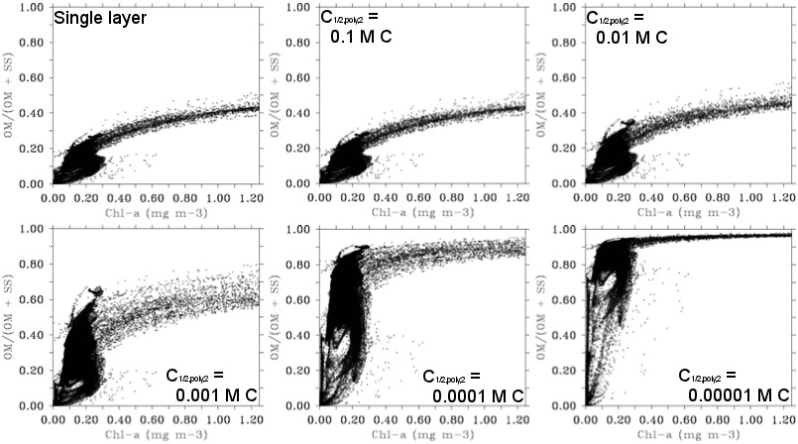
Lipid Sugar-Sticking: Causing Significant Increase in Emissions of Sea Spray Organic Matter?
Objective
Understand how soluble sugars stick to insoluble lipid monolayers at the surface of the ocean, and how this interaction may increase the amount of organic matter emitted in sea-spray aerosol.
Approach
High-resolution sum frequency generation spectroscopy experiments performed at DOE’s EMSL user facility showed direct evidence for adsorption of saccharides to lipid monolayers, bringing organic molecules to the surface that would otherwise have been dissolved.
Sensitivity of modeled sea-spray composition to this mechanism tested in OCEANFILMS model.
Top: Illustration of the single-component insoluble monolayer (left) and the formation of a second layer by soluble sugars sticking to the monolayer. Bottom: Potential impact of the two-layer treatment on organic mass fraction of sea spray in the OCEANFILMS model.
Impact
Interaction of sugars with surfactant films increases organic mass at the air-water interface.
This mechanism may explain discrepancies between models of organic enrichment in sea spray and measurements of sea-spray aerosol composition.
Burrows SM, E Gobrogge, L Fu, K Link, SM Elliott, H Wang, and R Walker. 2016. "OCEANFILMS-2: Representing Co-adsorption of Saccharides in Marine Films and Potential Impacts on Modeled Marine Aerosol Chemistry." Geophysical Research Letters, in press. DOI: 10.1002/2016GL069070
Notes:
http://www.pnnl.gov/science/highlights/highlights.asp?division=749

