Slide 1
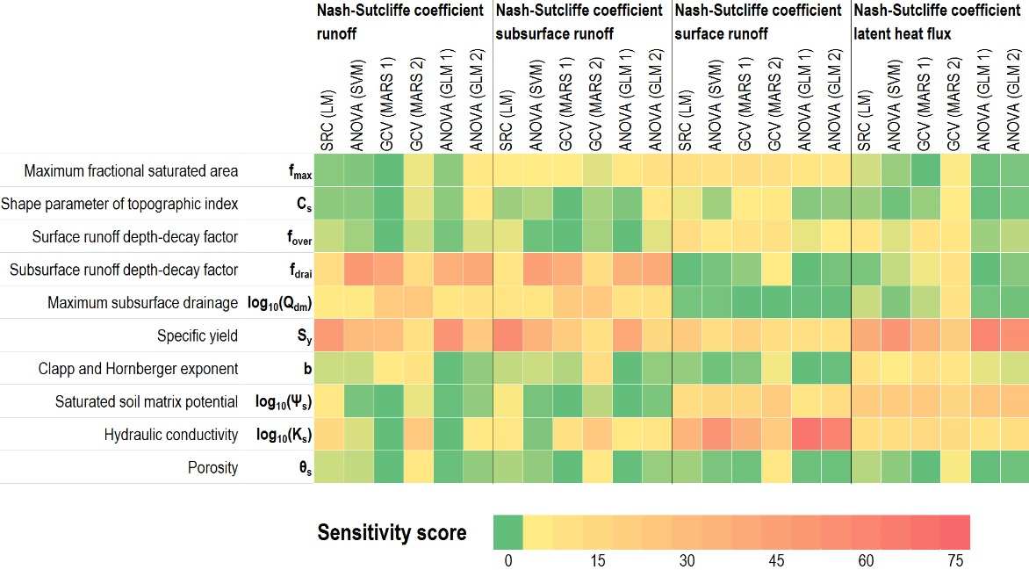
Simulating Hydrologic Flux Sensitivity to Model Parameters
in the Community Land Model
Sensitivity scores for different response variables/metrics and SA approaches
Objective
Evaluate various sensitivity analysis (SA) approaches for identifying important parameters and understanding uncertainty propagation in complex Earth system models
Approach
Sensitivity of simulated runoff and latent heat fluxes to hydrologic parameters in the Community Land Model version 4 (CLM4) were used as examples
Investigate four SA approaches including
Analysis of variance based on the generalized linear model;
Generalized cross validation based on the multivariate adaptive regression splines model;
Standardized regression based on a linear regression model, and
Analysis of variance based on support vector machine
Impact
Systematic evaluation of various widely-accepted SA methods and guidance on the optimal SA approaches;
SA approaches show consistent measures of major hydrologic parameters impacts on response variables, but with differences in the relative contributions, particularly for the secondary parameters;
The effects of linear, interaction, and high-order terms of input variables are explored and narrowed down to fewer terms to provide guidance on model optimization strategy.
Bao J, Z Hou, M Huang, Y Liu. 2015. “On Approaches to Analyze the Sensitivity of Simulated Hydrologic Fluxes to Model Parameters in the Community Land Model.” Water 7(12): 6810-6826. DOI:10.3390/w7126662
Notes:
http://www.pnnl.gov/science/highlights/highlights.asp?division=749

