Slide 1
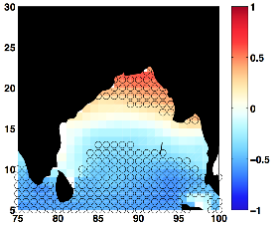
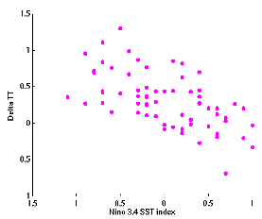
ENSO Induces a North-south Dipole in Pre-monsoon Bay of Bengal Tropical Cyclone Activity
Objective
Understand the observed changes in pre-monsoon tropical cyclone activity in the Bay of Bengal during 1979-2014 and explore the impact of remote teleconnection mechanisms.
Approach
Analyzed observed TC track data from the US Navy’s Joint Typhoon Warning Center.
Used ERA-Interim atmospheric reanalysis data to compute the GPI, monsoon index (Delta TT) and to understand tropical wave dynamics.
Used output from 15 different CMIP5 climate models to verify the relationship between the GPI and the large-scale TC environment and to project potential future changes in TC activity.
Left panel: Correlation between the GPI and the meridional tropospheric temperature gradient (Delta TT), an index representing the strength of the monsoon circulation, for May-June and for the period 1979-2013. The dipole in TC activity is clearly seen. Stippling indicates regions where the correlation is statistically significant at the 95% level. Right panel: Scatter between Delta TT (Y-axis) and the ENSO index (X-axis). Correlation coefficient is -0.65, which is significant at the 95% level.
Impact
Monsoon circulation changes induce a meridional dipole in pre-monsoon Bay of Bengal TC activity through changes in humidity, relative vorticity and vertical wind shear.
These changes in monsoon circulation are forced remotely by ENSO and the associated tropical wave dynamics.
Most climate models rightly reproduce the link between ENSO and pre-monsoon Bay of Bengal TC activity through the monsoon circulation.
Balaguru K, LR Leung, J Liu and GR Foltz. 2016. “A Meridional Dipole in Premonsoon Bay of Bengal Tropical Cyclone Activity Induced by ENSO.” Journal of Geophysical Research: Atmospheres 121. DOI:10.1002/2016JD024936
Notes:
http://www.pnnl.gov/science/highlights/highlights.asp?division=749

