Slide 1
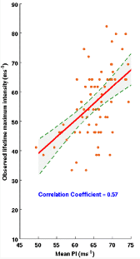
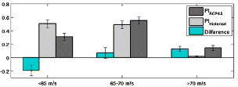
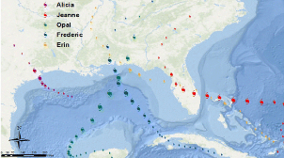
Thermodynamic Potential Intensity Projects Future Hurricane Storm Surge Risk for U.S. Gulf coasts
Objective
Estimate changes in future hurricane intensity based on the observed relationship between the mean Potential Intensity (PI) conditions experienced by hurricanes and their observed lifetime maximum intensity, and changes in mean PI conditions projected by climate models
Examine the impact of these hurricane intensity changes on future storm surge
Approach
Correlated mean PI conditions for Atlantic hurricanes, based on NCEP-DOE 2 reanalysis and NOAA SST data, with corresponding lifetime maximum intensities
Estimated projected changes in Atlantic hurricane intensity using historical hurricane tracks and 10 different CMIP5 climate models under the RCP4.5 scenario
Evaluated impact of hurricane intensity changes using the Sea, Lake and Overland Surges from Hurricanes (SLOSH) model and the tracks of 5 historical hurricanes that made landfall in the Gulf of Mexico and Florida
Left: Scatter between mean PI conditions experienced by Atlantic hurricanes (X-axis) with the observed lifetime maximum intensities (Y-axis). Top right: Probability distribution functions of PI conditions experienced by Atlantic hurricanes based on CMIP5 models. Bottom right: Tracks of 5 historical hurricanes used with the SLOSH model.
Impact
Lifetime maximum intensities of Atlantic hurricanes may increase by 4±1.3%, consistent with projections from dynamical downscaling studies
Increased storm surge due to increased hurricane intensities is about 10% of surge due to sea level rise.
Balaguru K, DR Judi and LR Leung. 2016. “Future Hurricane Storm Surge Risk for the U.S. Gulf and Florida Coasts Based on Projections of Thermodynamic Potential Intensity.” Climatic Change, DOI:10.1007/s10584-016-1728-8.
Notes:
http://www.pnnl.gov/science/highlights/highlights.asp?division=749

