Slide 1
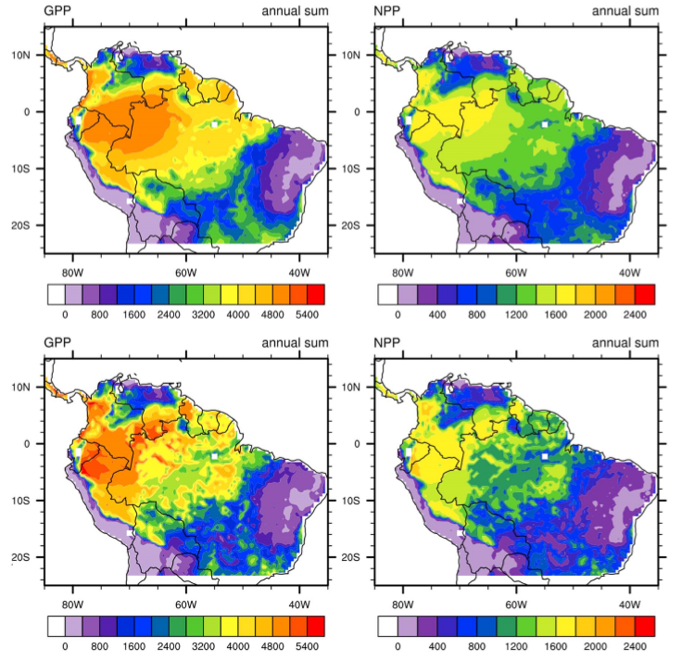
Phosphorus feedbacks may constrain tropical ecosystem responses to changes in atmospheric CO₂ and climate
Contact: Xiaojuan Yang, 865-574-7615, yangx2@ornl.gov
Funding: DOE Office of Science, Biological and Environmental Research
Objective
Explore how phosphorus cycling interacts with changes in atmospheric CO₂ and climate to affect historical and future carbon uptake in the Amazon region.
New Science
Model simulations show that the coupling of phosphorus dynamics reduces the simulated historical terrestrial carbon sink by about 26%
Exploratory model simulations highlights the importance of considering the interactions between carbon, water, and nutrient cycling for the prediction of future carbon uptake in tropical ecosystems
Significance
This study demonstrates the importance of phosphorus cycling in affecting tropical ecosystem responses to changes in atmospheric CO₂ and climate. These results highlight the need for new observations on how elevated CO₂ affects P dynamics, and the need for more tropical leaf-scale measurements under different temperature/humidity conditions and different levels of soil P availability
Simulated (left column) GPP (unit: gC/m2/yr) and (right column) NPP (unit: gC/m2/yr) for the Amazon region based on (top row) CLM-CN and (bottom row) CLM-CNP.
Citation
Yang, X., P. E. Thornton, D. M. Ricciuto and F. M. Hoffman 2016. Phosphorus feedbacks constraining tropical ecosystem responses to changes in atmospheric CO2 and climate. Geophysical Research Letters 43(13): 7205-7214 DOI: 10.1002/2016GL069241.
Notes:
Graphic in this slide shows: Simulated (left column) GPP (unit: gC/m2/yr) and (right column) NPP (unit: gC/m2/yr) for the Amazon region based on (top row) CLM-CN and (bottom row) CLM-CNP.

