Slide 1
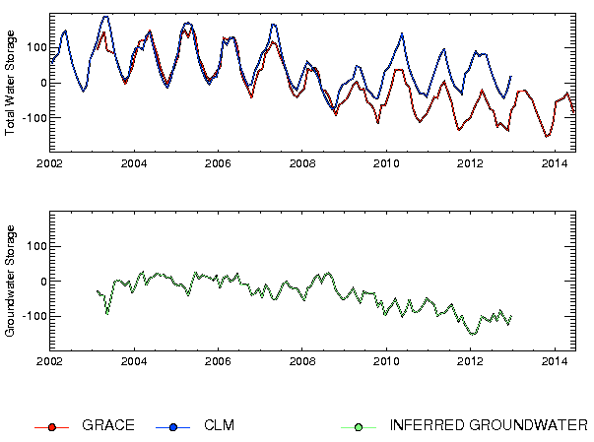
Assessing a dry surface layer-based soil resistance parameterization for the Community Land Model using GRACE and FLUXNET-MTE data
Objective
Impact
The Community Land Model (CLM) exhibits biases in evapotranspiration (ET) and total water storage (TWS) in semiarid regions. The TWS seasonal cycle amplitude is too low, while evapotranspiration is too strong and variable. These biases are consistent with excessive soil evaporation when the canopy is sparse or absent, which reduces moisture inputs into the ground. Here we improve the simulation of soil evaporation by replacing CLM’s existing empirical soil resistance parameterization with a more mechanistically based formulation in which soil evaporation is controlled by the rate of diﬀusion of water vapor through a dry surface layer (DSL).
Groundwater depletion is a grave concern in many parts of the world. Using GRACE data in conjunction with CLM model output, groundwater depletion has been observed in Northern India, the Middle East, and the United States. Estimates of human groundwater withdrawal are sensitive to model estimates of water storage. The parameterization described in this paper greatly improves GRACE-based groundwater withdrawal estimates in semiarid regions by reducing biases in CLM soil evaporation which greatly improves the CLM simulation of water storage variability.
Approach
The thickness of the DSL is parameterized as a soil-type dependent function of top layer soil moisture. Soil resistances are calculated from the DSL thickness combined with a soil tortuosity factor. Compared to the existing CLM soil resistance parameterization, the DSL-based soil resistances for a given soil moisture value are generally larger, especially for moister soils.
Compared to the existing CLM soil resistance parameterization, the DSL-based soil resistances for a given soil moisture value are generally larger, especially for moister soils. CLM simulations using the DSL-based soil resistance expression have reduced biases of ET relative to the FLUXNET-MTE (Model Tree Ensemble) data set and TWS relative to Gravity Recovery and Climate Experiment (GRACE) observations.
Reference: Swenson, S. C., and D. M. Lawrence (2014), Assessing a dry surface layer-based soil resistance parameterization for the Community Land Model using GRACE and FLUXNET-MTE data, J. Geophys. Res. Atmos., 119,doi:10.1002/2014JD022314.

