Slide 1
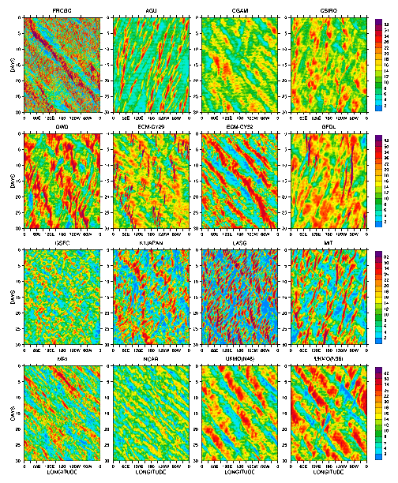
The Aqua-Planet Experiment (APE): CONTROL SST Simulation
Objective
This work compares idealized climates simulated by global AGCMs being developed and used for climate research and numerical weather prediction. The experiment involves complete AGCMs but on an idealized planet with simplified lower boundary consisting of an ocean everywhere with no land, orography or sea ice. The sea surface temperature (SST) is specified to be a zonally symmetric idealized distribution designed to mimic that in the Eastern Pacific. The configuration is designed to expose differences in the circulation simulated by different models. All standard diagnostic data received from the APE modeling groups are available from a Data Archive at the APE website.
Approach
Climate simulations by 16 atmospheric general circulation models (AGCMs) from around the world are compared. A multi-model mean and standard deviation are computed as a means of showing variation between the models in a concise form. The multi-model mean is not intended to be a reference solution for the, whose circulation cannot be precisely known. Basic features of the aqua-planet climate are characterized by comparison with Earth. The paper describe a range of circulation statistics from comparison of the APE models for the aqua-planet CONTROL SST experiment. The conclusions drawn from the different statistics are too numerous to catalogue here.
.
Impact
A wide range of model behavior is seen in most of the atmospheric circulation statistics. All aspects of tropical precipitation vary greatly between the models. The ITCZ appears as either a single peak on the equator or a double peak spanning the equator in individual models. The tropical precipitation displays a wide variation in behavior as illustrated in the figure which shows
Hovmoeller plots of equatorial precipitation (mm/day) averaged from 5S to 5N latitude for an arbitrary 30 period from each model. These and other results have spawned research into establishing the cause of the different behaviors.
M. Blackburn, D. L. Williamson, K. Nakajima, W. Ohfuchi, Y. O. Takahashi, Y.-Y. Hayashi, H. Nakamura, M. Ishiwatari, J. McGregor, H. Borth, V. Wirth, H. Frank, P. Bechtold, N. P. Wedi, H. Tomita, M. Satoh, M. Zhao, I. M. Held, M. J. Suarez, M.-I. Lee, M. Watanabe, M. Kimoto, Y. Liu, Z. Wang, A. Molod, K. Rajendran, A. Kitoh and R. Stratton, 2012: The Aqua-Planet Experiment (APE): CONTROL SST Simulation. J. Meteor. Soc. Japan, Accepted

