Slide 1
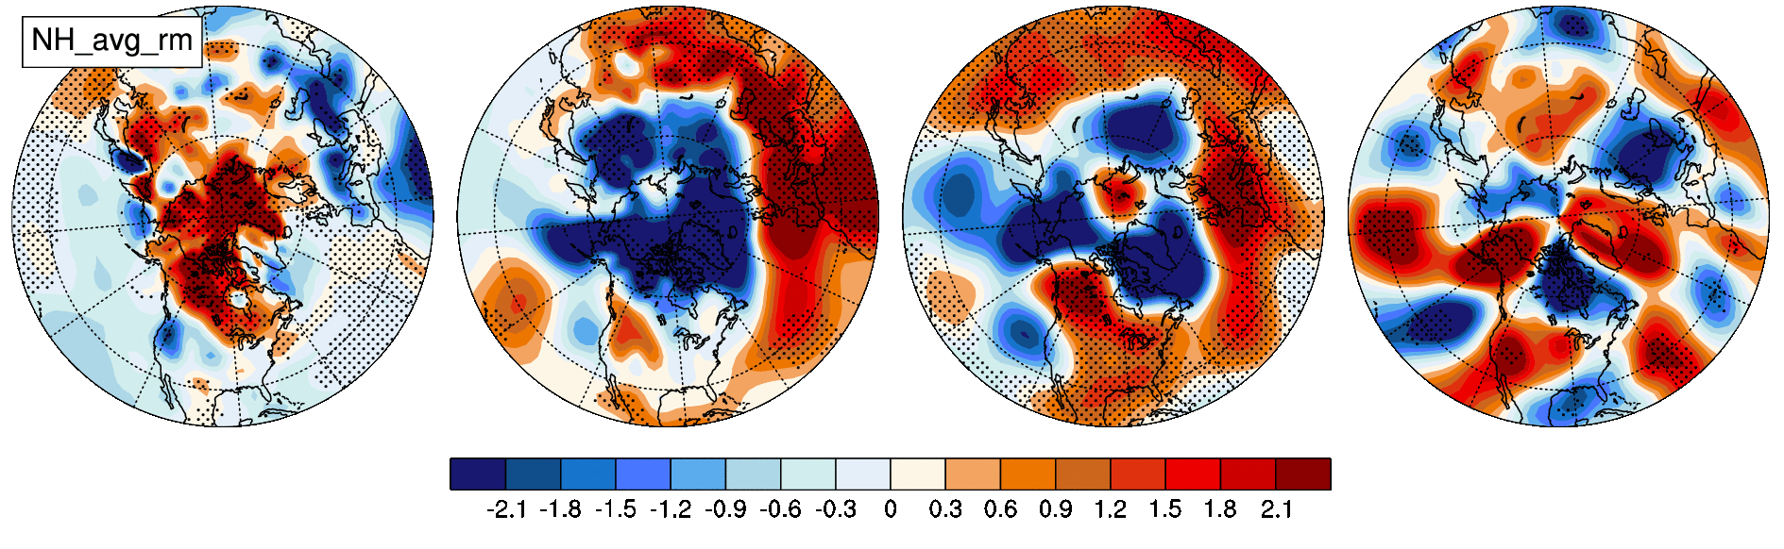
A Zonal Wavenumber-3 Pattern of Northern Hemisphere Wintertime Planetary Wave Variability at High Latitudes
Haiyan Teng and Grant Branstator
Objective
Document a prominent pattern of interannual variability of NH wintertime circulation at high latitudes, named Wave3. Wave3 is of interest because its spatial structure is similar to the observed circulation trend during the past 50 years or so.
(top) modal structure of the Wave3 pattern in DJF mean surface air temperature (TAS,C), sea level pressure (SLP, hPa), 500 hPa geopotential height (Z500, 10m), and 300h meridional wind (V300, m/s).
(bottom) 50-year linear trend
of the same variables during
1958-2011, with the NH area weighted averaged trend removed.
Approach
Determine the prominence of the Wave3 in the NCEP/NCAR reanalysis, long control integrations from both CCSM3 and its atmosphere component forced by climatological SSTs, and CMIP3 outputs.
Impact
The Wave3 pattern may shape the structure of trend and/or multi-decadal variability of the NH wintertime circulation at high latitudes.
Hence the properties and dynamical origins of this Wave3 pattern are important, especially to the climate research community that aims to project climate change on regional scale.
Teng, H. and G. Branstator, 2012: A zonal wavenumber-3 pattern of Northern Hemisphere wintertime planetary wave variability at high latitudes. J Climate, DOI:10.1175/JCLI-D-11-00664.1 .

