Slide 1
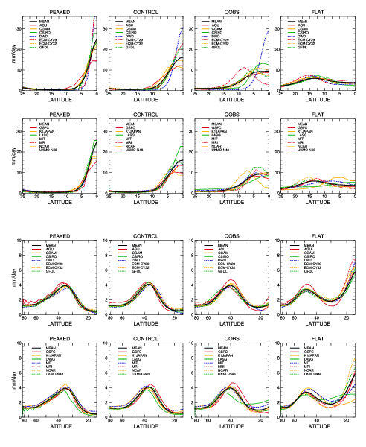
The Aqua-Planet Experiment (APE): Response to changed meridional SST profile
Objective
This work explores the sensitivity of Atmospheric General Circulation Model (AGCM) simulations to changes in the meridional distribution of sea surface temperature (SST) in an aqua-planet. Four hemispherically symmetric SST profiles are considered ranging from one in which the SST gradient continues to the equator (PEAKED) to one which is flat approaching the equator (FLAT), all with the same maximum SST at the equator.
Approach
Simulations from 14 atmospheric general circulation models (AGCMs) are studied. The Zonal mean circulation of all models shows strong sensitivity to latitudinal distribution of SST. As seen in the figure, which shows the zonal average precipitation (mm/day) from all models and experiments, the Hadley circulation weakens and shifts poleward as the SST profile flattens in the tropics. However, there is a large variation between models. One question of interest is the formation of a double versus a single ITCZ as this remains a problem in Earth-like simulations. There is a large variation between models of the strength of the ITCZ and where in the SST experiment sequence they transition from a single to double ITCZ. The tropical wave characteristics are also very different among the models for all SST
.
distributions (not shown). It is generally thought that much of the difference between atmospheric GCM simulations is due to the sub-grid scale parameterizations. However, in the APE models, resolution undoubtedly influences the interaction between the resolved dynamical flow and the parameterized moist processes since many of the APE models have relatively coarse resolution. Nevertheless, these resolutions are still commonly used for Earth simulations.
Impact
As with most intercomparison projects involving earth-like AGCMs it is difficult to determine the cause of the differences in the APE model behaviors. The issue now is to understand the causes of the different model responses. That requires further exploratory experiments, formation hypotheses and experiments to verify or refute the hypotheses. The Aqua-Planet Experiment results are stimulating researchers to do just that and they provide a significantly simpler environment to explore the differences that have been exposed.
D. L. Williamson, M. Blackburn, K. Nakajima, W. Ohfuchi, Y. O. Takahashi, Y.-Y. Hayashi, H. Nakamura, M. Ishiwatari, J. McGregor, H. Borth, V. Wirth, H. Frank, P. Bechtold, N. P. Wedi, H. Tomita, M. Satoh, M. Zhao, I. M. Held, M. J. Suarez, M.-I. Lee, M. Watanabe, M. Kimoto, Y. Liu, Z. Wang, A. Molod, K. Rajendran, A. Kitoh and R. Stratton, 2012: The Aqua-Planet Experiment (APE): Response to changed meridional SST profile. J. Meteor. Soc. Japan, Accepted

