Slide 1
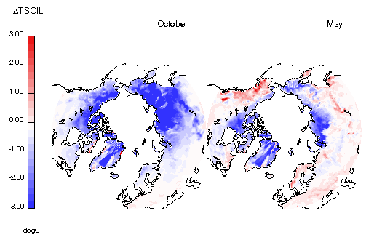
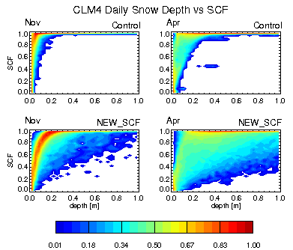
A New Fractional Snow-covered Area Parameterization for the Community Land Model and its Effect on the Surface Energy Balance
Objective
Fractional snow-covered area, or snow-covered fraction (SCF), within a
CLM4 grid cell is parameterized as a function of grid cell mean snow depth and snow density. This parameterization is based on an analysis of monthly averaged SCF and snow depth that showed a seasonal shift in the snow depth–SCF relationship. In this paper, we show that this shift is an artifact of the monthly sampling and that the current parameterization does not reflect the relationship observed between snow depth and SCF at the daily time scale. We demonstrate that the snow depth analysis used in the
original study exhibits a bias toward early melt when compared to satellite-observed SCF. This bias results in a tendency to overestimate SCF as a function of snow depth. Therefore, a new SCF parameterization based on snow water equivalent is developed to capture the observed seasonal snow depth–SCF evolution.
Approach
Impact
We demonstrate that the snow depth analysis used in the original study exhibits a bias toward early melt when compared to satellite-observed SCF. This bias results in a tendency to overestimate SCF as a function of snow depth. Using a more consistent, higher spatial and temporal resolution snow depth analysis reveals a clear hysteresis between snow accumulation and melt seasons.
To more realistically simulate environments having patchy snow cover, we modify the model by computing the surface fluxes separately for snow-free and snow-covered fractions of a grid cell. In this configuration, the form of the parameterized snow depth–SCF relationship is shown to greatly affect the surface energy budget. The direct exposure of the snow-free surfaces to the atmosphere leads to greater heat loss from the ground during autumn and greater heat gain during spring. The net effect is to reduce annual mean soil temperatures by up to 3 C in snow-affected regions.
Reference: Swenson, S. C., and D. M. Lawrence (2012), A new fractional snow-covered area parameterization for the Community Land Model and its effect on the surface energy balance, J. Geophys. Res., 117, D21107, doi:10.1029/2012JD018178.

