Slide 1
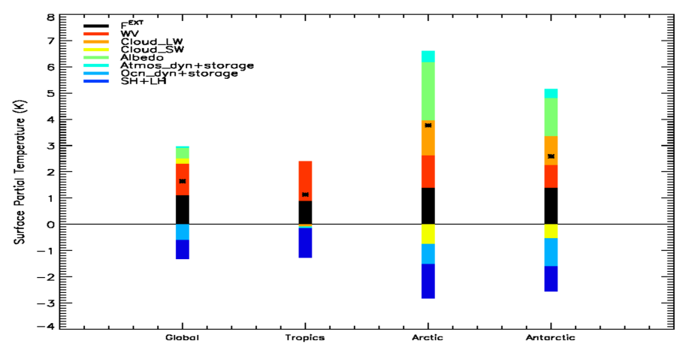
A Decomposition of Feedback Contributions to Polar Warming Amplification
Objective
Polar surface temperatures are expected to warm 2‑3 times faster than the global mean surface temperature; a phenomenon referred to as polar warming amplification. Therefore, understanding individual process contributions to the polar warming is critical to understanding global climate sensitivity.
Individual process contributions to the Global, tropical (20°N-20°S), Arctic (60°N-90°N), and Antarctic (60°S-90°S) regional average surface temperature response.
Approach
Impact
Here we used to the coupled feedback response analysis method (CFRAM) to decompose the annual and zonal mean, vertical temperature response within a transient 1% yr^{‑1} CO₂ increase simulation of the NCAR CCSM4 relative to the 1850 pre-industrial control simulation into individual radiative and non‑radiative climate feedback process contributions.
Our results show that surface albedo feedback contribute the most to the polar amplified warming, next is the net cloud feedback, followed by the external forcing and atmospheric dynamics. On the other hand, the water vapor feedback, ocean heat transport storage, and surface turbulent flux feedbacks contribute negatively to polar warming amplification, thus reducing the polar amplified warming.
Reference:Taylor, P. C., M. Cai, A. Hu, G. A. Meehl, W. M. Washington, G. J. Zhang, 2013, A Decomposition of Feedback Contributions to Polar Warming Amplification, J Climate, doi:10.1175/JCLI-D-12-00696, accepted.

