Slide 1
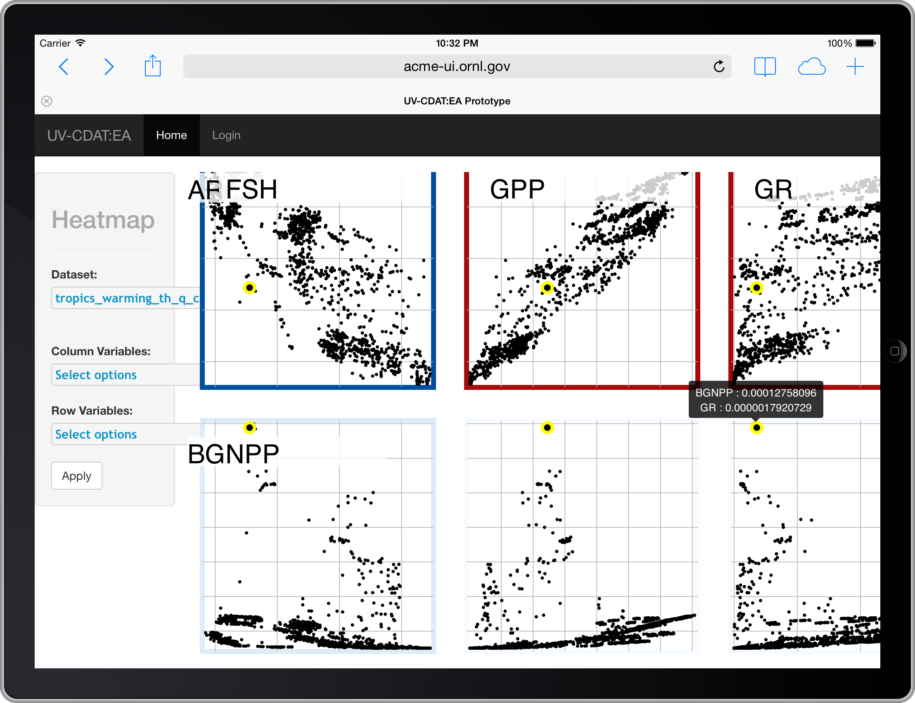
Web-based Visual Analytics for Extreme Scale Climate Science
Objectives
Impact
Design a web-based visual analysis system for large scale climate simulation analysis.
Remove deployment and usability barriers of traditional standalone data analysis tools such as tightly coupled dependencies.
Provide new exploratory visual analytics techniques in a convenient web application.
Democratize advanced visualization and analysis capabilities pertinent to large-scale earth system simulations.
Using distributed connections leverage HPC platforms via a web-based visual analysis application.
Accomplishments
New web-based interactive information visualization techniques for large-scale simulation data analysis
A tree-based visual exploration method for visually exploring hierarchical diagnostic parameter spaces
A level-of-detail (LOD) visual analysis system that allows interactive drill-down.
A loosely-coupled visual analysis architecture that connects Web-based visualization to fast diagnostic algorithms executing on HPC architectures
C.A. Steed, K.J. Evans, J.F. Harney, B.C. Jewell, G. Shipman, B.E. Smith, P.E. Thornton, and D.N Williams. “Web-based Visual Analytics for Extreme Scale Climate Science”, In Proceedings IEEE International Conference on Big Data, Oct. 2014. p383-392.
Our web-based system demonstrates visual analysis, backed by leadership class computing platforms (e.g. ORNL CADES or Titan). Here the system is being used on an iPad.
Notes:
1

Slide 2
Web-based Visual Analytics for Extreme Scale Climate Science
Summary
In this paper, we introduce a Web-based visual analytics framework for democratizing advanced visualization and analysis capabilities pertinent to large-scale earth system simulations. We address significant limitations of present climate data analysis tools such as tightly coupled dependencies, inefficient data movements, complex user interfaces, and static visualizations. Our Web-based visual analytics framework removes critical barriers to the widespread accessibility and adoption of advanced scientific techniques. Using distributed connections to back-end diagnostics, we minimize data movements and leverage HPC platforms. We also mitigate system dependency issues by employing a RESTful interface. Our framework embraces the visual analytics paradigm via new visual navigation techniques for hierarchical parameter spaces, multi-scale representations, and interactive spatio-temporal data mining methods that retain details. Although generalizable to other science domains, the current work focuses on improving exploratory analysis of large-scale Community Land Model (CLM) and Community Atmosphere Model (CAM) simulations.
C.A. Steed, K.J. Evans, J.F. Harney, B.C. Jewell, G. Shipman, B.E. Smith, P.E. Thornton, and D.N Williams. “Web-based Visual Analytics for Extreme Scale Climate Science”, In Proceedings IEEE International Conference on Big Data, Oct. 2014. p383-392.
Notes:
Location parameter: indicates the position of the distribution of extremes from the origin (.i.e the change in location parameter implies a shift in the distribution of values).
2

